Slide 1
Extraction of Iodine
E. Haniff

Slide 2
Aim
To extract iodine from an aqueous solution of iodine

Slide 3
Apparatus and Materials
Separating funnel
Beakers/containers
Retort stand
Aqueous solution (iodine in water)
Organic solvent

Slide 4
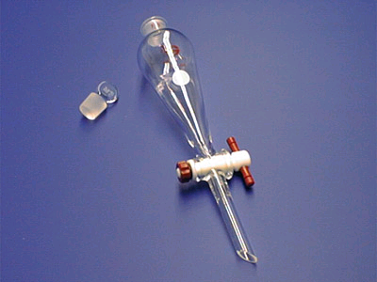
Reminder… A Separating funnel looks like this:

Slide 5
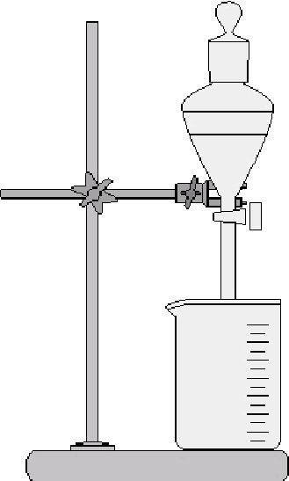
Diagram:

Slide 6
Method:
The apparatus was set up as shown in the diagram
25cm³ of the aqueous iodine solution were placed into a separating funnel
20cm3 of the organic solvent were added to the separating funnel
The separating funnel was then covered and shaken thoroughly and replaced on the stand
The layers were allowed to separate
Observations were noted

Slide 7
Method:
The lower layer was drained into a beaker
The process was repeated and observed
The tap was opened periodically to release pressure build up from vapours formed

Slide 8
Observations
After shaking and settling, the organic layer changed from colourless to ……..
This indicated that the iodine from the water layer had moved into the organic layer

Slide 9
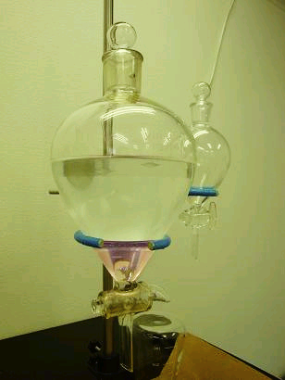
An image of iodine extracted from sea water

Slide 10
Discussion
Solvent extraction is the removal of a substance from one solvent into another solvent.
It works on the principle of:
The immiscibility of the two solvents
The substance is more soluble in the other solvent

Slide 11
Discussion continued
Iodine is more soluble in the organic solvent than in water
Water and the inorganic solvent are immiscible
Repeating the process allowed greater extraction of iodine from the water
Solvent extraction is a good method of separating organic substances from aqueous solutions (eg. Removing caffeine from coffee)…see video on website
The iodine could be retrieved from the organic solvent by gently evaporating the solvent

Slide 12
Conclusion
The method of solvent extraction was used to extract iodine from an aqueous solution into an organic solvent
Solvent extraction is a useful technique in the removal of a substance from one solvent into another solvent

Slide 13
Sublimation lab
E. Haniff

Slide 14
Aim
To separate a mixture of sodium chloride and ammonium chloride using sublimation

Slide 15
Apparatus and Materials
Evaporating basin
Funnel
Tripod
Bunsen burner
Sodium chloride
Ammonium chloride

Slide 16
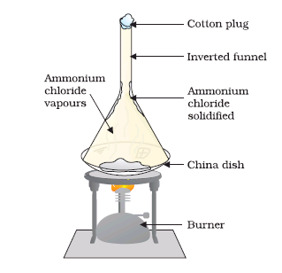
Diagram

Slide 17
Method
The apparatus was set up as shown in the diagram and the mixture of sodium chloride and ammonium chloride was heated
Observations were noted

Slide 18
Observations:
White fumes were observed rising from the mixture
A white crystalline solid was formed on the inside of the funnel

Slide 19
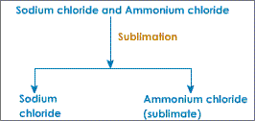
Observation:

Slide 20
Discussion:
Sublimation is used to separate a solid which sublimes from a mixture of solids
Sublimation is the direct conversion of a solid to a vapour on heating and a vapour to a solid on cooling
Ammonium chloride sublimes but sodium chloride does not, so sublimation is a suitable technique for the separation of these two solids
Both of these substances are soluble in water, so the method of filtration is unsuitable to separate sodium chloride from ammonium chloride

Slide 21
Discussion continued:
Gentle heating of the mixture caused the sublimation of ammonium chloride into the inverted funnel
The vapours rose but upon contact with the cooler surface of the funnel caused them to return to a solid state, and the white substance could be seen
The sodium chloride was unaffected by the gentle heating and remained in the evaporating dish
Some other solids which sublime include: Iodine, Carbon dioxide, Naphthalene (moth balls)

Slide 22
Conclusion:
The method of sublimation was used to separate a mixture of sodium chloride and ammonium chloride
Ammonium chloride is a solid that sublimes

Slide 23
Applications of sublimation
Used in the purification of compounds in chemistry and in pharmaceuticals
Forensic analysis

